Slide 1

Oracle 12c: SQL
Chapter 6
Additional Database Objects
©2016. Cengage Learning. All rights reserved.

Slide 2
Objectives
Define the purpose of a sequence and state how it can be used in a database
Explain why gaps may appear in the integers generated by a sequence
Use the CREATE SEQUENCE command to create a sequence
Call and use sequence values
Identify which options cannot be changed by the ALTER SEQUENCE command
Delete a sequence
©2016. Cengage Learning. All rights reserved.

Slide 3
Objectives (continued)
Create indexes with the CREATE INDEX command
Explain the main index structures: B-tree and bitmap
Verify index use with the explain plan
Introduce variations on conventional indexes, including a function-based index and an index organized table
©2016. Cengage Learning. All rights reserved.

Slide 4
Objectives (continued)
Verify index existence via the data dictionary
Rename an index with the ALTER INDEX command
Remove an index using the DELETE INDEX command
Create and remove a public synonym
©2016. Cengage Learning. All rights reserved.

Slide 5
Database Objects
An object is anything that has a name and defined structure
Includes:
  Table – stores data
  Sequence – generates sequential integers
  Index – allows users to quickly locate specific records
  Synonym – alias for other database objects
©2016. Cengage Learning. All rights reserved.

Slide 6
Sequences
Used for internal control purposes by providing sequential integers for auditing
Used to generate unique value for primary key column
  Surrogate key = no correlation with actual row contents
©2016. Cengage Learning. All rights reserved.

Slide 7
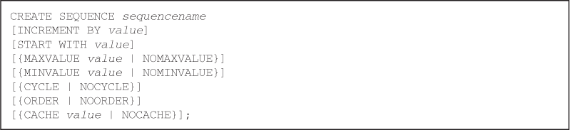
Creating a Sequence
Use the CREATE SEQUENCE command
Various intervals are allowed – Default: 1
You can specify the starting number – Default: 1
©2016. Cengage Learning. All rights reserved.
Notes:
Increments –you might use increments of 1 for Checks and invoices, but a random number credit cards or bank account numbers so no two numbers are similar ( 1391)

Slide 8
Creating a Sequence
Increments
Normally 1. . . .you might use increments of 1 for checks and invoices, but a random number credit cards or bank account numbers so no two numbers are similar ( increment of 13,591)
Oracle 11g: SQL

Slide 9
Creating a Sequence
MAXVALUE/MINVALUE
Can specify MINVALUE for decreasing sequence and MAXVALUE for increasing sequence
Oracle 11g: SQL

Slide 10
Creating a Sequence
CYCLE
Numbers can be reused if CYCLE is specified. If you reached your max/min value, it will start the cycle again. Default setting is NOCYCLE.
Oracle 11g: SQL

Slide 11
Creating a Sequence
ORDER
ORDER clause is used in application cluster environment. Multiple users could request sequence values at the same time. The ORDER clause returns sequenced values in the same order that the requests are received. NOORDER is the default.
Oracle 11g: SQL

Slide 12
Creating a Sequence
CACHE
Generating sequenced values can slow down the processing requests from other users. If NOCACHE is specified when the sequenced is create, it is created when the request is received. Use CACHE to pre-generate integers – Default: CACHE20

Slide 13
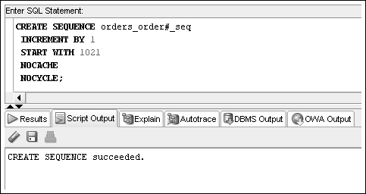
Creating a Sequence (continued)
©2016. Cengage Learning. All rights reserved.

Slide 14
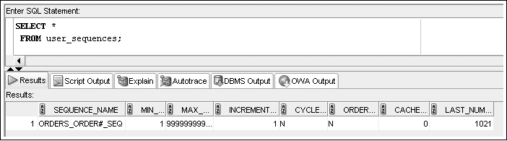
Creating a Sequence (continued)
To verify the settings for options of a sequence, query USER_SEQUENCES data dictionary view
Next Number to issue
©2016. Cengage Learning. All rights reserved.

Slide 15
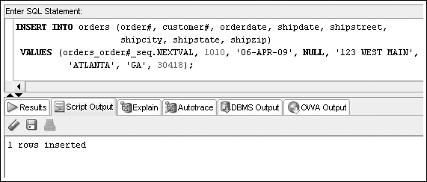
Using Sequence Values
NEXTVAL – generates integer
©2016. Cengage Learning. All rights reserved.

Slide 16
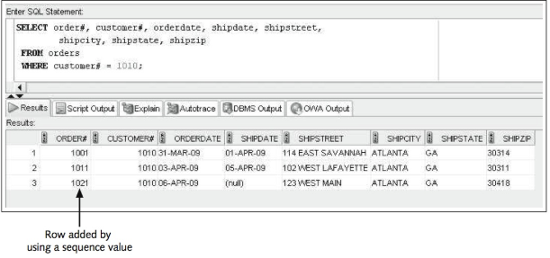
Check it out. . . .
Oracle 11g: SQL

Slide 17
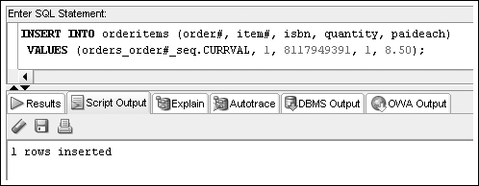
Using Sequence Values (continued)
CURRVAL – contains last integer generated by NEXTVAL
©2016. Cengage Learning. All rights reserved.

Slide 18
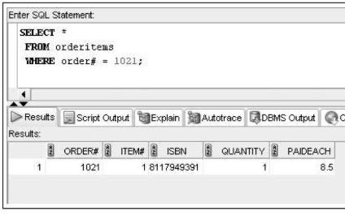
Check it out
Oracle 11g: SQL

Slide 19
Differences NEXTVAL/CURRVAL
"Within a single SQL statement, Oracle will increment the sequence only once per row. If a statement contains more than one reference to NEXTVAL for a sequence, Oracle increments the sequence once and returns the same value for all occurrences of NEXTVAL. If a statement contains references to both CURRVAL and NEXTVAL, Oracle increments the sequence and returns the same value for both CURRVAL and NEXTVAL regardless of their order within the statement. "
Basic Elements of Oracle SQL, 6 of 10
Oracle 11g: SQL

Slide 20
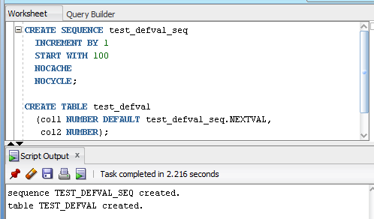
Using Sequence Values (continued)
Set column DEFAULT value
©2016. Cengage Learning. All rights reserved.

Slide 21
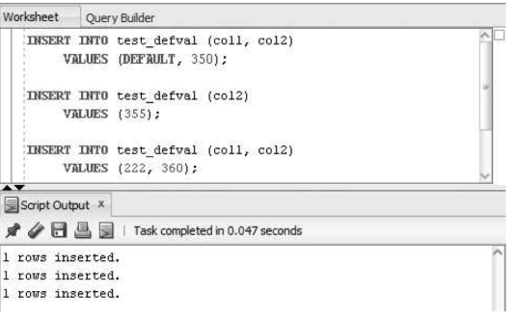
Using Sequence Values (continued)
Insert data
©2016. Cengage Learning. All rights reserved.

Slide 22
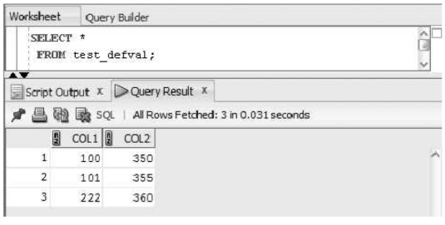
Using Sequence Values (continued)
Check it out. . . .
©2016. Cengage Learning. All rights reserved.

Slide 23
Altering Sequence Definitions
Use ALTER SEQUENCE command to change the settings for a sequence
START WITH value cannot be altered – drop the sequence and re-create it
Changes cannot make current integers invalid
©2016. Cengage Learning. All rights reserved.

Slide 24
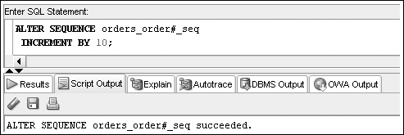
ALTER SEQUENCE Command Example
©2016. Cengage Learning. All rights reserved.

Slide 25
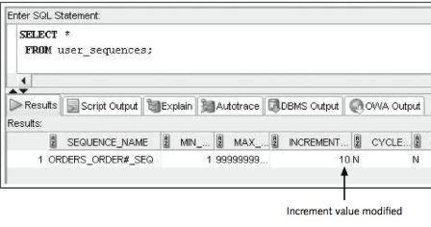
Check it out
Oracle 11g: SQL

Slide 26
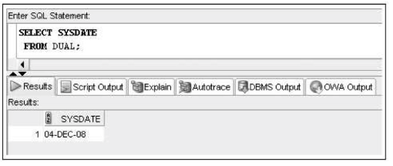
DUAL table
Sometimes the information you want is not in a table. . . . But you always need a SELECT and a FROM to run a query. You can bypass this with the DUAL table
Oracle 11g: SQL

Slide 27
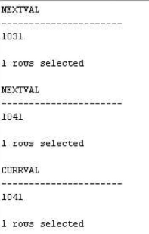
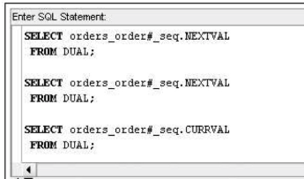
Try it out . . . .
Oracle 11g: SQL

Slide 28
Removing a Sequence
Use the DROP SEQUENCE command to delete a sequence
Previous values generated are not affected by removing a sequence from a database
©2016. Cengage Learning. All rights reserved.

Slide 29
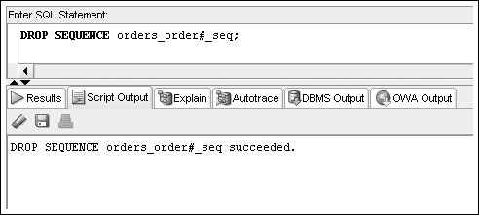
Removing a Sequence (continued)
©2016. Cengage Learning. All rights reserved.

Slide 30
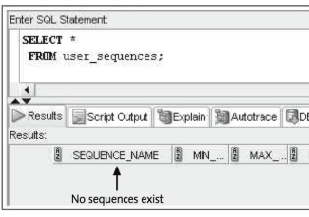
Check it out. . .
Oracle 11g: SQL

Slide 31
Create an Identity Column
Only one identity defined per table is allowed
The IDENTITY clause automatically creates a sequence and default setting for the column, as well as a NOT NULL and UNIQUE constraint.
The IDENTITY column must use the NUMBER data type.
A DEFAULT clause cannot be assigned to an IDENTITY column
It will enforce an “always” option. So a value cannot be specified to insert into a column
©2016. Cengage Learning. All rights reserved.

Slide 32
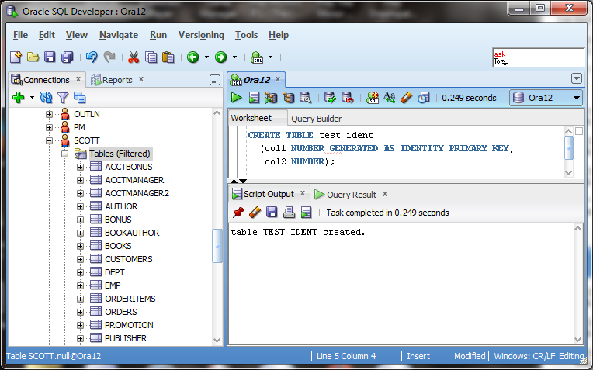
Create an Identity Column
Alternative to using sequences to populate primary key columns
©2016. Cengage Learning. All rights reserved.

Slide 33
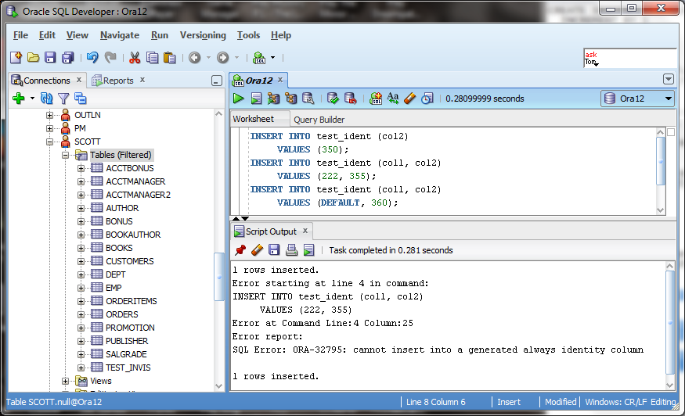
Using an Identity Column
©2016. Cengage Learning. All rights reserved.

Slide 34
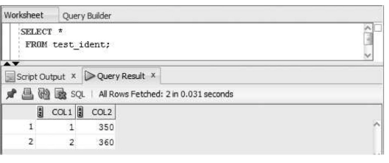
Check it out . . .
Oracle 11g: SQL

Slide 35
Indexes
An index stores frequently referenced values and ROWIDs(Physical address of table row –row.id)
Can be based on one column, multiple columns, functions, or expressions
©2016. Cengage Learning. All rights reserved.

Slide 36
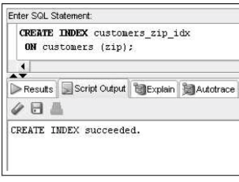
Try it out. . . .
Oracle 11g: SQL

Slide 37
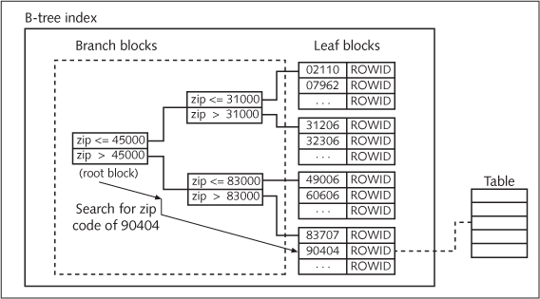
B-Tree Index
©2016. Cengage Learning. All rights reserved.

Slide 38
B-Tree Index (continued)
Implicitly create an index by PRIMARY KEY and UNIQUE constraints
Explicitly create an index by using the CREATE INDEX command
©2016. Cengage Learning. All rights reserved.

Slide 39
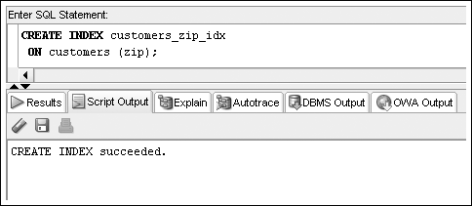
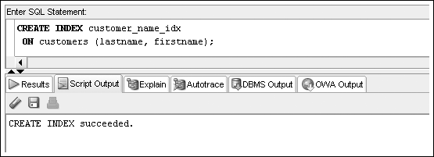
CREATE INDEX Command Examples
©2016. Cengage Learning. All rights reserved.

Slide 40
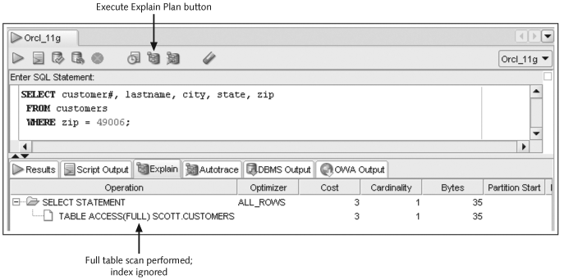
The Explain Plan
©2016. Cengage Learning. All rights reserved.

Slide 41
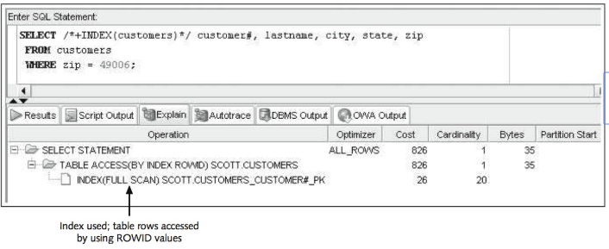
Try it out. . . .
Oracle 11g: SQL

Slide 42
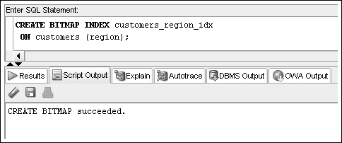
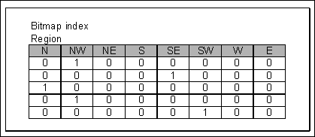
Bitmap Indexes
©2016. Cengage Learning. All rights reserved.

Slide 43
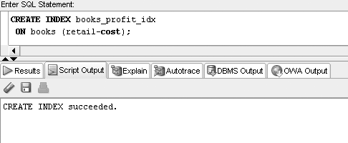
Function-Based Indexes
©2016. Cengage Learning. All rights reserved.

Slide 44
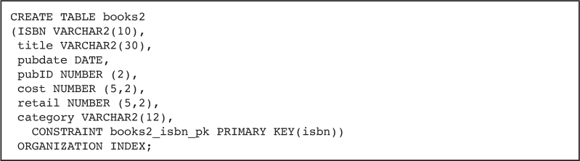
Index Organized Tables
An IOT stores table contents in a B-tree index structure
Use the “ORGANIZATION INDEX” option in a CREATE TABLE statement to build an IOT
©2016. Cengage Learning. All rights reserved.

Slide 45
Verifying an Index
Use the USER_INDEXES data dictionary view to determine that the index exists
Use the USER_IND_COLUMNS data dictionary view to determine the column index information
©2016. Cengage Learning. All rights reserved.

Slide 46
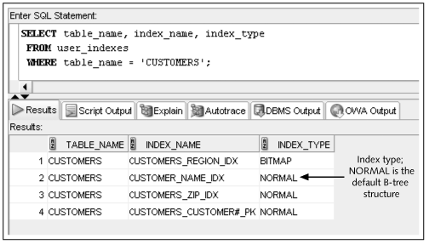
Verifying an Index (continued)
©2016. Cengage Learning. All rights reserved.

Slide 47
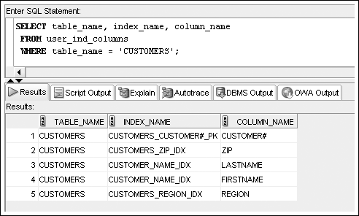
USER_IND_COLUMNS
©2016. Cengage Learning. All rights reserved.

Slide 48
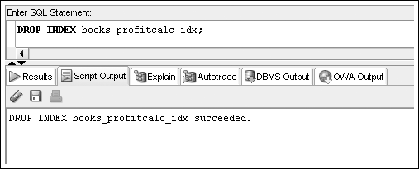
Removing an Index
Use the DROP INDEX command to remove an index
©2016. Cengage Learning. All rights reserved.

Slide 49
Synonyms
Synonyms serve as permanent aliases for database objects
Simplify object references
Can be private or public
  Private synonyms are only available to the user who created them
  PUBLIC synonyms are available to all database users
©2016. Cengage Learning. All rights reserved.

Slide 50
CREATE SYNONYM Command Syntax
©2016. Cengage Learning. All rights reserved.

Slide 51
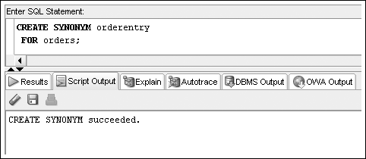
CREATE SYNONYM Command
©2016. Cengage Learning. All rights reserved.

Slide 52
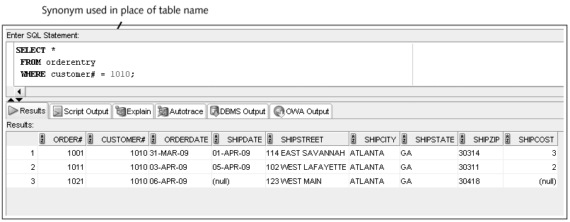
CREATE SYNONYM Command
©2016. Cengage Learning. All rights reserved.

Slide 53
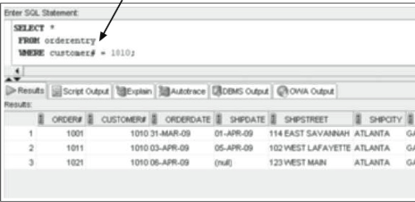
Check it out
Oracle 11g: SQL

Slide 54
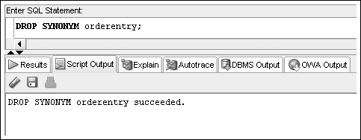
Deleting a SYNONYM
A private synonym can be deleted by its owner
A PUBLIC synonym can only be deleted by a user with DBA privileges
©2016. Cengage Learning. All rights reserved.

Slide 55
Summary
A sequence can be created to generate a series of integers
The values generated by a sequence can be stored in any table
A sequence is created with the CREATE SEQUENCE command
Gaps in sequences might occur if the values are stored in various tables, if numbers are cached but not used, or if a rollback occurs
A value is generated by using the NEXTVAL pseudocolumn
The CURRVAL pseudocolumn is NULL until a value is generated by NEXTVAL
The USER_OBJECTS data dictionary object can be used to confirm the existence of all schema objects
The USER_SEQUENCES data dictionary object is used to view sequence settings
A sequence may be set as a column DEFAULT value
An identity column can be created to manage primary key population as an alternative to using sequences
©2016. Cengage Learning. All rights reserved.

Slide 56
Summary (continued)
The ALTER SEQUENCE command is used to modify an existing sequence; the only settings that can’t be modified are the START WITH option and any option that would be invalid because of previously generated values
The DUAL table is helpful for testing sequence value generation
The DROP SEQUENCE command deletes an existing sequence
An index can be created to speed up the query process
DML operations are always slower when indexes exist
Oracle 11g creates an index for PRIMARY KEY and UNIQUE constraints automatically
An explicit index is created with the CREATE INDEX command
An index can be used by Oracle 11g automatically if a query criterion or sort operation is based on a column or an expression used to create the index
©2016. Cengage Learning. All rights reserved.

Slide 57
Summary (continued)
The two main structures for indexes are B-tree and bitmap
The explain plan can verify whether an index is used in a query
Function-based indexes are used to index an expression or the use of functions on a column or columns
An index organized table is a table stored in a B-tree structure to combine the index and table into one database object
Information about an index can be retrieved from the USER_INDEXES and USER_IND_COLUMNS views
An index can be dropped with the DROP INDEX command
An index can be renamed with the ALTER INDEX command
©2016. Cengage Learning. All rights reserved.

Slide 58
Summary (continued)
Except for a name change, an index can’t be modified; it must be deleted and then re-created
A synonym provides a permanent alias for a database object
A public synonym is available to any database user
A private synonym is available only to the user who created it
A synonym is created by using the CREATE SYNONYM command
A synonym is deleted by using the DROP SYNONYM command
Only a user with DBA privileges can drop a public synonym
©2016. Cengage Learning. All rights reserved.

